Slide 1
Automated Dimension Measuring
Submitted By:
Ali Dbouk
Mohammad Mahdi Kassem
Mostafa Kabalan
Ali Saleh

Slide 2
Table of contents
01
02
04
05
Introduction
Future Development
06
Objectives
Conclusion
03
07
How The Code Works
References
Project Evaluation

Slide 3
01
Introduction

Slide 4
Introduction
The automated measuring object project aims to develop a system that automates the process of scanning and measuring objects accurately.
Traditional object scanning methods often require manual adjustments and measurements, which can be time-consuming and prone to errors.
This project utilizes computer vision techniques and the OpenCV library to create a more efficient and reliable object scanning solution.

Slide 5
02
Objectives

Slide 6
Objectives
The main objectives of the project are as follows:
Develop a system to automatically scan pictures using either a webcam or an input image.
Detect the contours of the A4 paper in the captured image.
Calculate the 2D dimensions of the object by using a known reference dimension (in our case the A4 paper [29.7 cm , 21 cm ].
Display the scanned document with annotated dimensions.
Enable users to accurately measure the length and width of the document using the displayed dimensions.

Slide 7
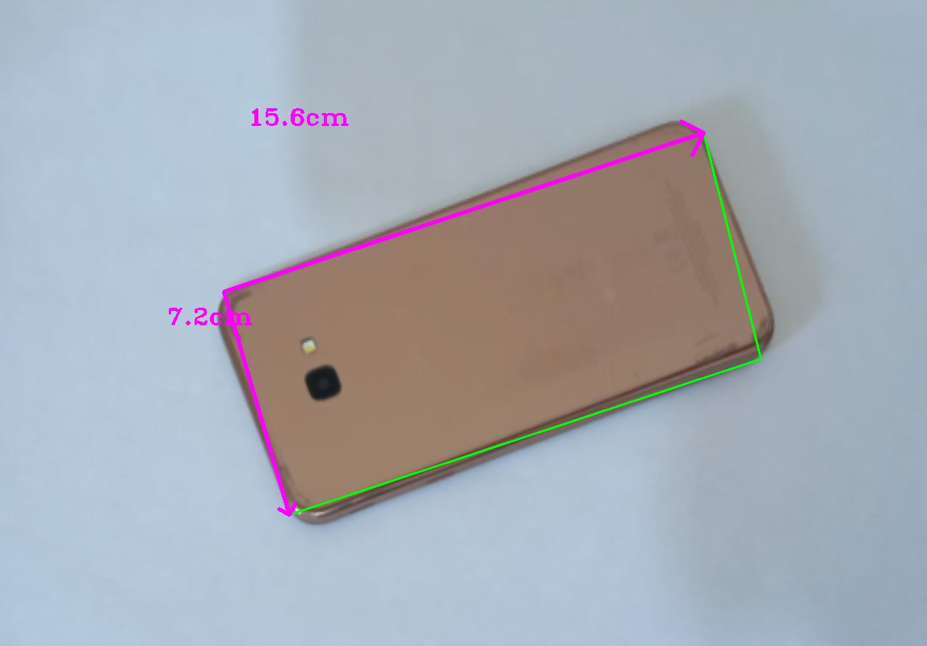
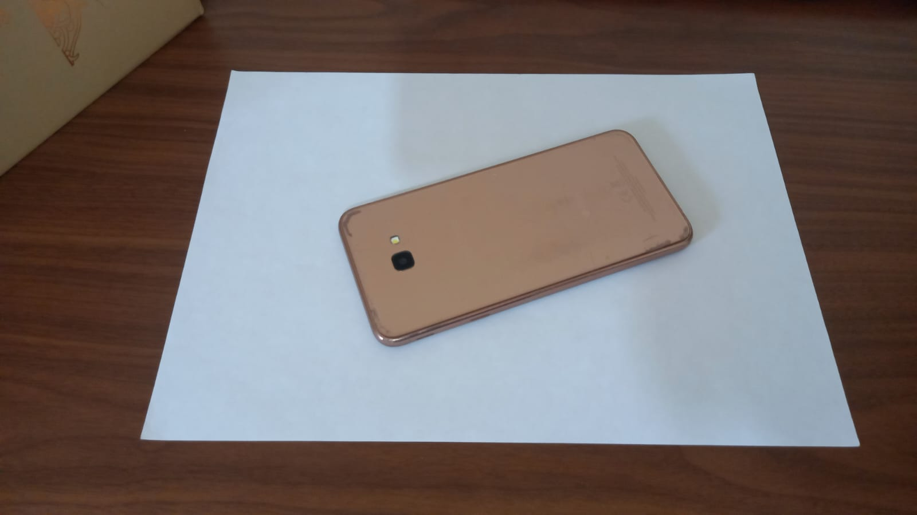
First let’s present the project

Slide 8
03
How The Code Works

Slide 9
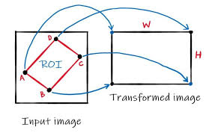
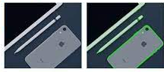
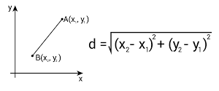
First, let’s define some important functions and explain how they work
Get
Contours
Perspective Transformation
Distance Calculation

Slide 10
Get Contours

Slide 11
Get Contours function
Function Definition:
The Get Contours function takes an image as input.
And returns a list[] of final contours.
To achieve that we must pass through several steps and algorithms

Slide 12
First image processing

Slide 13
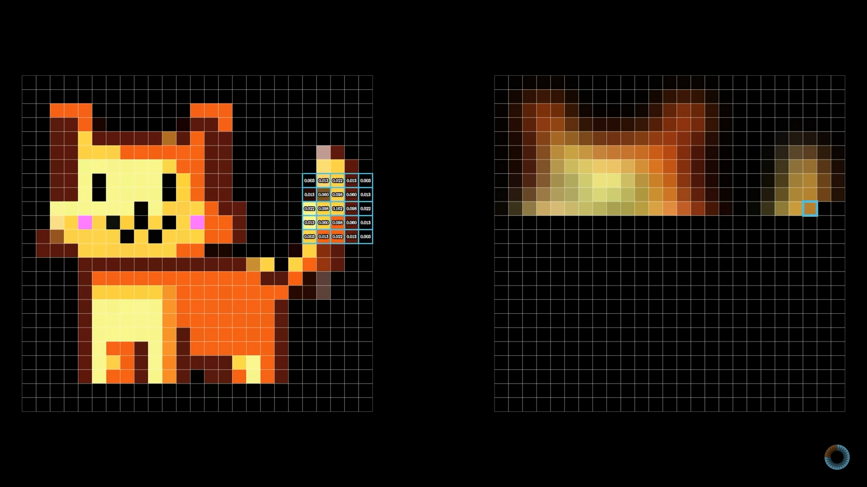
convoluting the blur matrix over the original picture result in blurring it

Slide 14
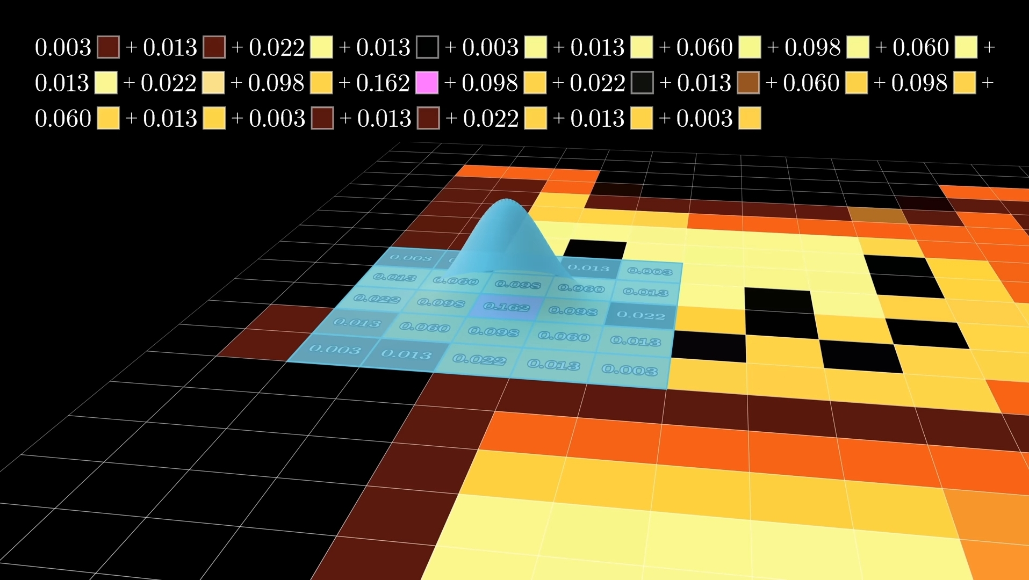

Slide 15
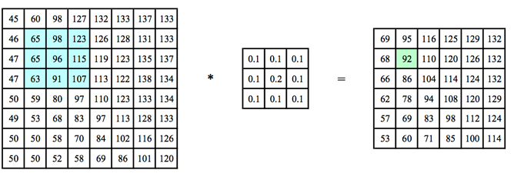
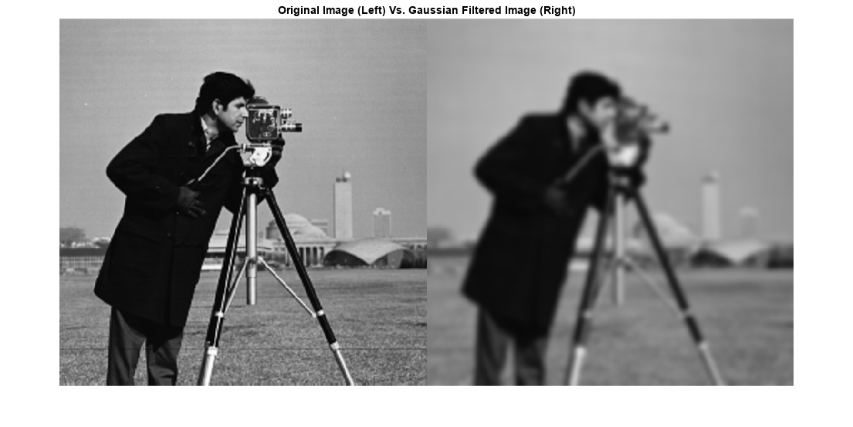
Gaussian Blur filter is used to filter out any noise.
Gaussian kernel of size=3
Input image
output image

Slide 16
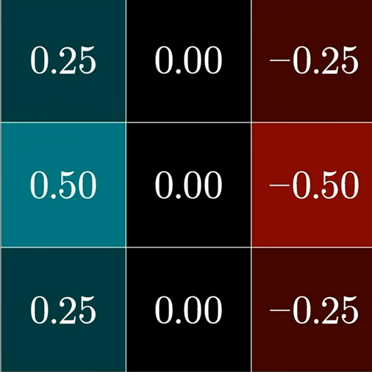
Can you predict what effect this will have on the final image ??

Slide 17
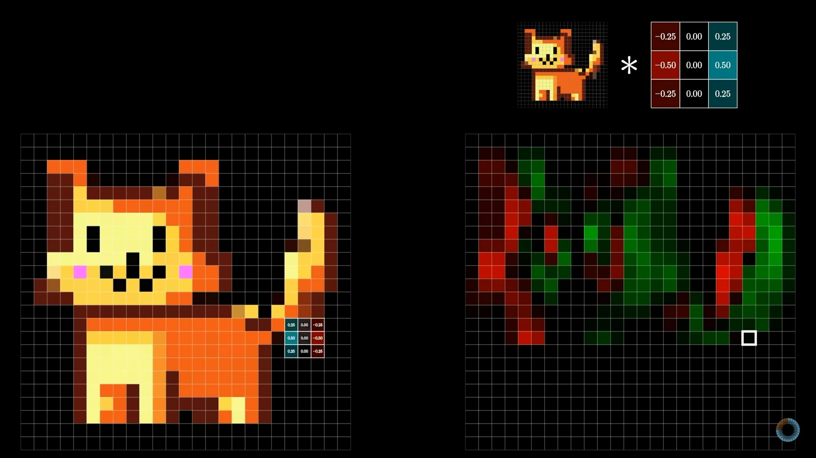

Slide 18
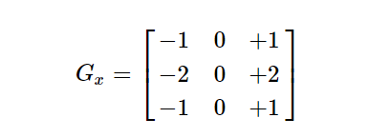
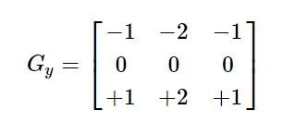
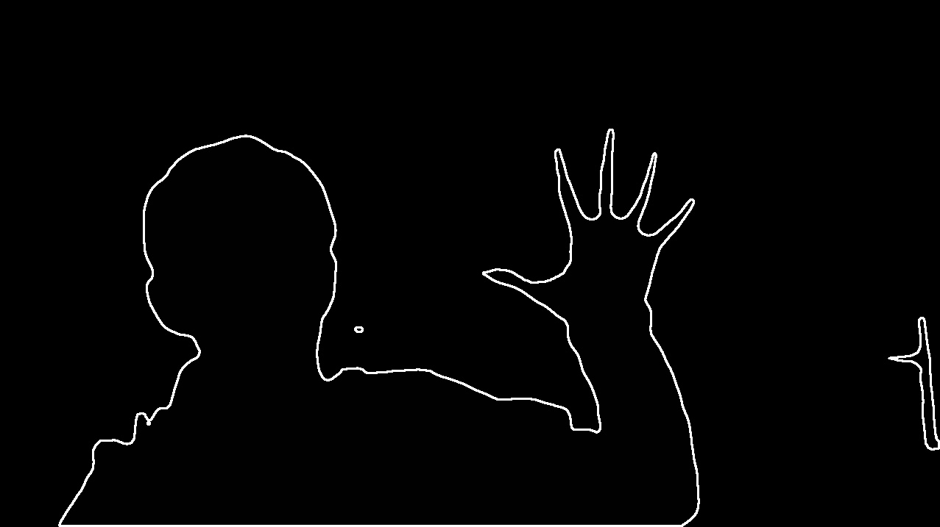
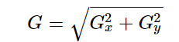
Canny Edge Detector
Find the intensity gradient of the image. For this, we follow this procedure:
Apply a pair of convolution masks (in x and y directions):
Find the gradient strength:

Slide 19
Extracting contours
In cv2.findContours(), finding contours is like finding a white object from a black background. So remember, the object to be found should be white and the background should be black.

Slide 20
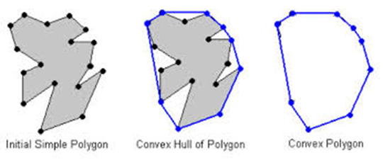
Filtering and Approximating Contours
Collect in a new list the contours of the following properties:
Closed
Area > min Area
4 edges (Approximating takes place before counting the edges)
Approximating is done using cv2.approxPolyDP(0.02*perimeter(contour))
Which uses Ramer–Douglas–Peucker algorithm.

Slide 21
To Summarize:

Slide 22
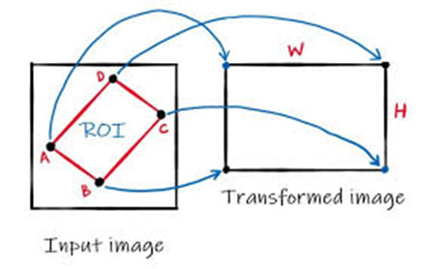
warpImg Function

Slide 23
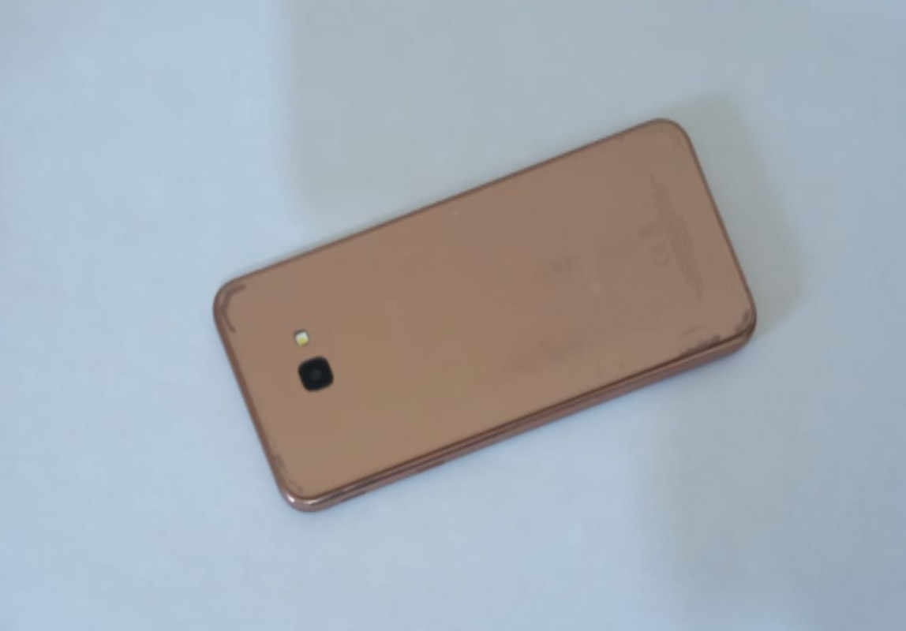
Knowing the 4 corners

Slide 24
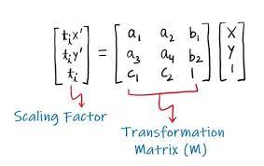
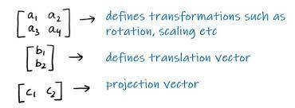
Perspective Transformation
In general, the perspective transformation can be expressed as
The transformation matrix (M) can be seen as a combination of
But first, the input points should be ordered

Slide 25
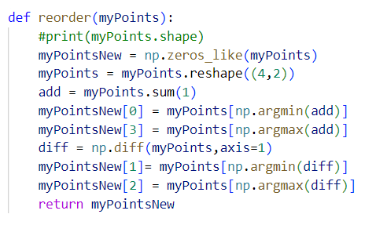
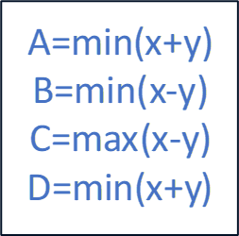
Reorder function
Such that:

Slide 27
Distance Calculation

Slide 28
Distance Calculation
Function Definition:
The find_Dis() function takes two parameters: pts1 and pts2, which represent the coordinates of two points in a two-dimensional space.
It returns the Euclidean distance between the two points.

Slide 29
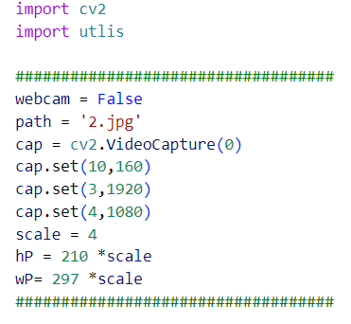
Main Program
Importing Libraries
Initializing Variables
Main Loop

Slide 31
Image Evolution

Slide 32
04
Project Evaluation

Slide 33
Project Evaluation
In this section, we will analyze the measurement errors. The aim of this analysis is to provide an understanding of the accuracy and precision of the measurements taken by the software. The data used for analysis includes the comparison between the true measurements and the machine measurements of approximately 24 sampled items.

Slide 34
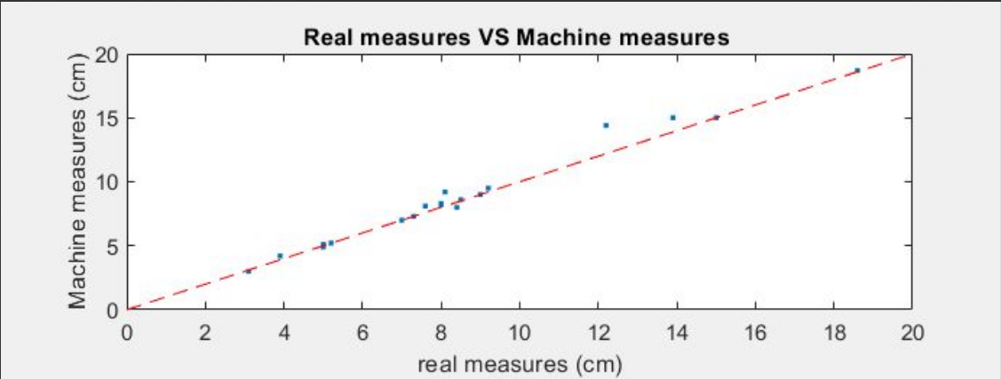
Measurement results:
Here is a graph done using Matlab shows the sample of measures measured using the program in comparison to its real measures

Slide 35
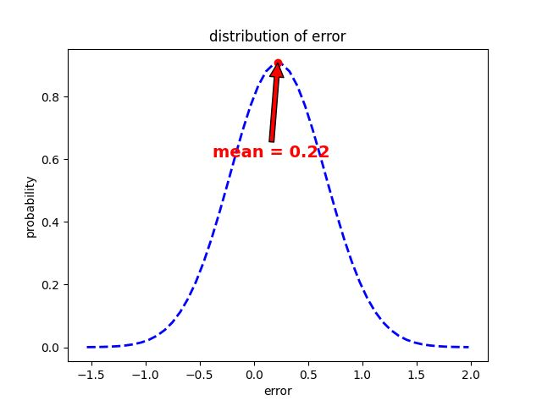
Error Estimation :
Upon analyzing the collected data, it was found that the mean error between the true measurements and the machine measurements was approximately +0.22 cm.
The standard deviation of the error was determined to be 4mm.

Slide 36
Interpretation of the results
The mean error of 0.22 cm suggests a slight systematic bias in the measurements obtained from the object measurement software. This bias could be justified as flow:
Merging the object shadow in the object’s contour
Merging the object side thickness in the object’s contour
Bended A4 edges
Misleading objects or noisy objects (contain many details)

Slide 37
05
Future Development

Slide 38
Ideas For the future of the project:
Automatic document classification: Extend the project to automatically classify different types of documents based on their shapes or content. This could be achieved by training a machine learning model on a dataset of various document types.
Optical character recognition (OCR): Implement OCR techniques to extract text from scanned documents, enabling users to search and analyze the text within the documents.
Cloud integration: Allow users to store scanned documents in cloud storage services such as Google Drive or Dropbox for easy access and sharing.

Slide 39
06
Conclusion

Slide 40
Conclusion
The automated Dimension measuring project offers a practical solution for scanning and measuring documents accurately. By leveraging OpenCV's computer vision capabilities, the system can detect document contours, calculate their dimensions, and display the results. The project has the potential for further development and integration with additional features like document classification, OCR, and cloud storage. Overall, this project showcases the capabilities of computer vision in automating document scanning processes.

Slide 41
Questions?

Slide 42
References :
Freecodecamp : https://youtu.be/oXlwWbU8l2o
https://theailearner.com/2020/11/06/perspective-transformation/
https://docs.opencv.org/4.x/d4/d73/tutorial_py_contours_begin.html
https://docs.opencv.org/4.x/da/d5c/tutorial_canny_detector.html
https://stackoverflow.com/questions/41402137/opencv-splitting-contours

